Slide 1

Stack and Queue
SoftUni Team
Technical Trainers
Software University
https://softuni.bg

Slide 2
Table of Contents
Algorithmic Complexity
Stack - Last In First Out (LIFO)
Stack Functionality
Java Stack Implementation
Overview of All Operations
Queue - First In First Out(FIFO)
Queue Functionality
Queue Implementation
Overview of All Operations
Priority Queue

Slide 3

Algorithmic Complexity

Slide 4
Algorithmic Complexity
Describes performance of particular algorithm
Runtime and memory consumption based on the input size N
We usually care about the worst-case performance
We measure the complexity as the Big O notation
Numerical function depending on the input size O(N)
We measure time as the number of simple steps
We measure memory as input data N by it's type size

Slide 5
Algorithmic Complexity
O(1) – Constant time – time does not depend on N
O(log(N)) – Logarithmic time – grows with rate as log(N)
O(N) – Linear time grows at the same rate as N
O(N^2),O(N^3) – Quadratic, Cubic grows as square or cube of N
O(2^N) – Exponential grows as N becomes the exponent worst algorithmic complexity
For input size of 10 - 1024 steps
For input size of 100 – 1267650600228229401496703205376 steps
http://bigocheatsheet.com/

Slide 6
Asymptotic Functions
Below are some examples of common algorithmic grow:

Slide 7
Get Sum Number of Steps
Calculate maximum steps to find sum of even elements in an array
Assume that a single step is a single CPU instruction:
assignments, array lookups, comparisons, arithmetic operations
Solution:
T(n) = 9n + 3
int getSumEven(int[] array) {
int sum = 0;
for (int i = 0; i < array.length; i++)
if (array[i] % 2 == 0) sum += array[i];
return sum;
}
Counting maximum steps is called worst-case analysis

Slide 8
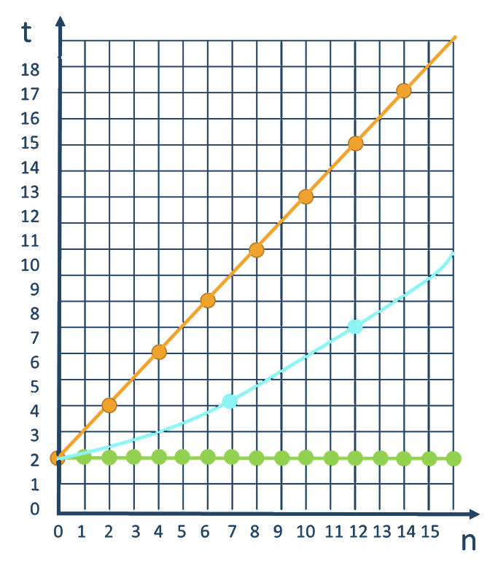
Time Complexity
Worst-case
An upper bound on the running time
Average-case
Average running time
Best-case
The lower bound on the running time (the optimal case)

Slide 9
Stacks and Queue vs. ArrayDeque
Why don't use Stack and Queue?
Implementation details which make unsecure usability
In many cases those structures will decrease the performance
Why to use ArrayDeque?
Implementation which makes the structure more secure
Better performance and usability
Methods which operate as those structures suggest

Slide 10

Stack

Slide 11
Stack Functionality
Stacks provide the following functionality:
Pushing an element at the top of the stack
Popping element from the top of the stack
Getting the topmost element without removing it
10
10
10
5
5
5
2
2
2
Push
Pop
Peek
11

Slide 12
ArrayDeque<E> – Java Stack Implementation
Creating a Stack
Adding elements at the top of the stack
Removing elements
Getting the value of the topmost element
ArrayDeque<Integer> stack = new ArrayDeque<>();
stack.push(element);
Integer element = stack.pop();
Integer element = stack.peek();

Slide 13
Stack – Utility Methods
ArrayDeque<Integer> stack = new ArrayDeque<>();
int size = stack.size();
boolean isEmpty = stack.isEmpty();
boolean exists = stack.contains(2);

Slide 14
Stack – Overview of All Operations
10
5
5
2
15
-7
132
Stack<Integer>
push()
2
0
1
3
4
pop()
size():
5
5
peek()

Slide 15
Problem: Browser History
Write a program which takes 2 types of browser instructions:
Normal navigation: a URL is set, given by a string
The string "back" that sets the current URL to the last set URL
Input
Output
https//softuni.bg/
back
https//softuni.bg/trainings/courses
back
https//softuni.bg/trainings/2056
back
https//softuni.bg/trainings/live
https//softuni.bg/trainings/live/details
Home
https//softuni.bg/
no previous URLs
https//softuni.bg/trainings/courses
https//softuni.bg/
https//softuni.bg/trainings/2056
https//softuni.bg/
https//softuni.bg/trainings/live
https//softuni.bg/trainings/live/details

Slide 16
Solution: Browser History (1)
Scanner scanner = new Scanner(System.in);
ArrayDeque<String> browser = new ArrayDeque<>();
String line = scanner.nextLine();
String current = "";
// continue…
Check your solution here: https://judge.softuni.bg/Contests/1437/Stacks-and-Queues-Lab
16

Slide 17
Solution: Browser History (2)
while(!line.equals("Home")) {
if(line.equals("back")) {
if(!browser.isEmpty()) { current = browser.pop();
} else {
System.out.println("no previous URLs");
line = scanner.nextLine();
continue; }
} else {
if(!current.equals("")) { browser.push(current); }
current = line; }
System.out.println(current);
line = scanner.nextLine(); }
17

Slide 18
Problem: Simple Calculator
Implement a simple calculator that can evaluate simple expressions (only addition and subtraction)
Input
Output
2 + 5 + 10 - 2 - 1
14
2 - 2 + 5
5
Check your solution here: https://judge.softuni.bg/Contests/1437/Stacks-and-Queues-Lab

Slide 19
Solution: Simple Calculator (1)
Scanner scanner = new Scanner(System.in);
String[] tokens = scanner.nextLine().split("\\s+");
Deque<String> stack = new ArrayDeque<>();
Collections.addAll(stack, tokens);
// continues…
Split by regex
Adds a collection to another collection
Check your solution here: https://judge.softuni.bg/Contests/1437/Stacks-and-Queues-Lab

Slide 20
Solution: Simple Calculator (2)
while (stack.size() > 1) {
int first = Integer.valueOf(stack.pop());
String op = stack.pop();
int second = Integer.valueOf(stack.pop());
switch (op)
case "+": stack.push(String.valueOf(first + second));
break;
case "-": stack.push(String.valueOf(first - second));
break;
}
System.out.println(stack.pop());
Check your solution here: https://judge.softuni.bg/Contests/1437/Stacks-and-Queues-Lab

Slide 21
Problem: Decimal to Binary Converter
Create a converter which takes a decimal number and converts it into a binary number
Input
Output
10
1010
1024
10000000000
Check your solution here: https://judge.softuni.bg/Contests/1437/Stacks-and-Queues-Lab

Slide 22
Solution: Decimal to Binary Converter
Scanner scanner = new Scanner(System.in);
int decimal = Integer.valueOf(scanner.nextLine());
ArrayDeque<Integer> stack = new ArrayDeque<>();
// TODO: check if number is 0
while (decimal != 0)
stack.push(decimal % 2);
decimal /= 2;
while (!stack.isEmpty())
System.out.print(stack.pop());
Check your solution here: https://judge.softuni.bg/Contests/1437/Stacks-and-Queues-Lab
22

Slide 23
Problem: Matching Brackets
We are given an arithmetical expression with brackets (with nesting)
Goal: extract all sub-expressions in brackets
1 + (2 - (2 + 3) * 4 / (3 + 1)) * 5
(2 + 3)
(3 + 1)
(2 - (2 + 3) * 4 / (3 + 1))
Check your solution here: https://judge.softuni.bg/Contests/1437/Stacks-and-Queues-Lab

Slide 24
Solution: Matching Brackets (1)
Scanner scanner = new Scanner(System.in);
String expression = scanner.nextLine();
Deque<Integer> stack = new ArrayDeque<>();
// continue…
Check your solution here: https://judge.softuni.bg/Contests/1437/Stacks-and-Queues-Lab

Slide 25
Solution: Matching Brackets (2)
for (int i = 0; i < expression.length(); i++) {
char ch = expression.charAt(i);
if (ch == '(')
stack.push(i);
else if (ch == ')')
int startIndex = stack.pop();
String contents = expression.substring(startIndex, i + 1);
System.out.println(contents);
}
Check your solution here: https://judge.softuni.bg/Contests/1437/Stacks-and-Queues-Lab

Slide 26

Queues

Slide 27
Queue
First In First Out
2
5
10

Slide 28
Queue – Abstract Data Type
Queues provide the following functionality:
Adding an element at the end of the queue
Removing the first element from the queue
Getting the first element of the queue without removing it
2
5
10
2
5
10
2
5
10

Slide 29
ArrayDeque<E> – Java Queue Implementation
Creating a Queue
Adding elements at the end of the queue
add() – throws exception if queue is full
offer() – returns false if queue is full
ArrayDeque<Integer> queue = new ArrayDeque<>();
queue.add(element);
queue.offer(element);

Slide 30
ArrayDeque<E> – Java Queue Implementation (2)
Removing elements
remove() - throws exception if queue is empty
poll() - returns null if queue is empty
Check first element
element = queue.remove();
element = queue.poll();
element = queue.peek();

Slide 31
Add() / Offer()
Adds an element to the queue
4
2
3
1
Queue<Integer>
size():
0
-3
15
121
5

Slide 32
Remove() / Poll()
Returns and removes first element
4
2
size():
3
Queue<Integer>
121
15
-3
5

Slide 33
Problem: Hot Potato
Children form a circle and pass a hot potato clockwise
Every n^{th} toss a child is removed until only one remains
Upon removal the potato is passed forward
Print the child that remains last
Input
Output
Sam John Sara
2
Removed John
Removed Sam
Last is Sara
Check your solution here: https://judge.softuni.bg/Contests/1437/Stacks-and-Queues-Lab

Slide 34
Solution: Hot Potato (1)
Scanner scanner = new Scanner(System.in);
String[] children = scanner.nextLine().split("\\s+");
int n = Integer.valueOf(scanner.nextLine());
ArrayDeque<String> queue = new ArrayDeque<>();
for (String child : children)
queue.offer(child);
// continue…
Check your solution here: https://judge.softuni.bg/Contests/1437/Stacks-and-Queues-Lab

Slide 35
Solution: Hot Potato (2)
while (queue.size() > 1) {
for (int i = 1; i < n; i++)
queue.offer(queue.poll());
System.out.println("Removed " + queue.poll());
}
System.out.println("Last is " + queue.poll());
Check your solution here: https://judge.softuni.bg/Contests/1437/Stacks-and-Queues-Lab

Slide 36
ArrayDeque<E> – Java Queue Implementation (3)
Utility Methods
peek() - checks the value of the first element
size() - returns queue size
toArray() - converts the queue to an array
contains() - checks if element is in the queue
Integer element = queue.peek();
Integer size = queue.size();
Integer[] arr = queue.toArray();
boolean exists = queue.contains(element);

Slide 37
Peek()
Gets the first element without removing it
size():
2
Queue<Integer>
121
15
15

Slide 38
Problem: Math Potato
Rework the previous problem so that a child is removed only on a prime cycle (cycles start from 1)
If a cycle is not prime, just print the child's name
Input
Output
Maria Peter George
2
Removed Peter
Prime Maria
Prime George
Removed Maria
Last is George
Check your solution here: https://judge.softuni.bg/Contests/1437/Stacks-and-Queues-Lab

Slide 39
Solution: Math Potato
int cycle = 1;
while (queue.size() > 1) {
for (int i = 1; i < n; i++)
queue.offer(queue.poll());
if (isPrime(cycle))
System.out.println("Prime " + queue.peek());
else
System.out.println("Removed " + queue.poll());
cycle++;
}
System.out.println("Last is " + queue.poll());
Check your solution here: https://judge.softuni.bg/Contests/1437/Stacks-and-Queues-Lab

Slide 40
Queue – Overview of All Operations
4
0
1
2
size():
3
Queue<Integer>
-3
15
121
15
5
5
add()
peek()
remove()

Slide 41
Priority Queue
Retains a specific order to the elements
Higher priority elements are pushed to the beginning of the queue
Lower priority elements are pushed to the end of the queue
A
B
C

Slide 42

Summary
…
…
…
Algorithmic Complexity
Stack - Last In First Out (LIFO)
push(), pop(), peek()
Queue - First In First Out (FIFO)
add(), poll(), peek()
Priority Queue

Slide 43
Multidimensional Arrays
SoftUni Team
Technical Trainers
Software University
https://softuni.bg

Slide 44
Table of Contents
Arrays in Java
What is Multidimensional Array?
Declaring and Creating Multidimensional Arrays
Initializing Multidimensional Arrays
Accessing Elements
Reading a Matrix

Slide 45
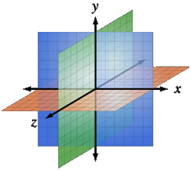
Multidimensional Arrays

Slide 46
Array in Java
In programming array is a sequence of elements
All elements are of the same type
The order of the elements is fixed
Has fixed size (length)
0 1 2 3 4
Element index
Array of 5 elements
… | … | … | … | …
Element of an array

Slide 47
Working with Arrays in Java
Allocating an array :
Assigning values to the array elements:
Accessing array elements :
Array of 10 elements
int[] numbers = new int[10];
for (int i = 0; i < numbers.length; i++)
numbers[i] = i + 1;
All elements are of the same type
numbers[3] = 20;
numbers[5] = numbers[2] + numbers[7];
Element index

Slide 48
What is Multidimensional Array?
An array is a systematic arrangement of similar objects
Arrays can have more than one dimension, e.g. matrices
The most used multidimensional arrays are the 2-dimensional
Matrix | COLUMS
R O W S | [0][0] | [0][1] | [0][2] | [0][3]
 | [1][0] | [1][1] | [1][2] | [1][3]
 | [2][0] | [2][1] | [2][2] | [2][3]
 | [3][0] | [3][1] | [3][2] | [3][3]
Row Index
Column Index

Slide 49
Declaring and Creating Multidimensional Arrays
Declaring multidimensional arrays:
Creating a multidimensional array
Use new keyword
Must specify the size of at least one dimension
int[][] intMatrix;
float[][] floatMatrix;
String[][][] strCube;
int[][] intMatrix = new int[3][];
float[][] floatMatrix = new float[8][2];
String[][][] stringCube = new String[5][5][5];

Slide 50
Initializing Multidimensional Arrays
Initializing a multidimensional array with values:
Matrices are represented by a list of rows
Each row consists of a list of values
int[][] matrix = {
{1, 2, 3, 4}, // row 0 values
{5, 6, 7, 8} // row 1 values
};

Slide 51
Accessing Elements
Accessing N-dimensional array element:
Getting element value example:
Setting element value example:
nDimensionalArray[index₁] … [index_{n}]
int[][] array = {{1, 2}, {3, 4}};
int element = array[1][1]; // element₁₁ = 4
 | 0 | 1
0 | 1 | 2
1 | 3 | 4
int[][] array = new int[3][4];
for (int row = 0; row < array.length; row++)
for (int col = 0; col < array[0].length; col++)
array[row][col] = row + col;

Slide 52
Reading a Matrix – Example
public static void main(String[] args) {
Scanner scanner = new Scanner(System.in);
int rows = Integer.parseInt(scanner.nextLine());
int cols = Integer.parseInt(scanner.nextLine());
int[][] matrix = new int[rows][cols];
for (int row = 0; row < rows; row++) {
String[] inputTokens = scanner.nextLine().split(" ");
for (int column = 0; column < cols; column++) {
matrix[row][column] =
Integer.parseInt(inputTokens[column]);
}
}
}

Slide 53
Problem: Compare Matrices
Write a program that reads two integer matrices (2D arrays) from the console and compares them element by element
Print equal if the matrices match, and not equal if they don't match
Input | Output
2 1 2 3 2 1 3 2 1 2 3 2 1 3 | Equal
Check your solution here: https://judge.softuni.bg/Contests/1459/Multidimensional-Arrays-Lab

Slide 54
Solution: Compare Matrices (1)
int[] dimentions = Arrays.stream(scanner.nextLine()
.split("\\s++"))
.mapToInt(Integer::parseInt)
.toArray();
int firstMatrixRows = dimentions[0];
int firstMatrixCols = dimentions[1];
// TODO: continue…
Check your solution here: https://judge.softuni.bg/Contests/1459/Multidimensional-Arrays-Lab
54

Slide 55
Solution: Compare Matrices (2)
for (int i = 0; i < firstMatrixRows; i++) {
int[] arr = Arrays.stream(scanner.nextLine()
.split("\\s+"))
.mapToInt(Integer::parseInt)
.toArray();
firstMatrix[i] = arr;
}
// TODO: read second matrix…
Check your solution here: https://judge.softuni.bg/Contests/1459/Multidimensional-Arrays-Lab
55

Slide 56
Solution: Compare Matrices (3)
static boolean matricesAreEqual(int[][] firstMatrix, int[][] secondMatrix) {
if (firstMatrix.length != secondMatrix.length) return false;
for (int row = 0; row < firstMatrix.length; row ++) {
if (firstMatrix[row].length != secondMatrix[row].length)
return false;
for (int col = 0; col < firstMatrix[row].length; col ++) {
if (firstMatrix[row][col] != secondMatrix[row][col]) return false;
}
}
return true;
}
56

Slide 57
Problem: Positions of
Write a program that reads a matrix of integers, then a number and prints all the positions at which that number appears in the matrix
The matrix definition on the console will contain a line with two positive integer numbers R and C
If the number does not appear in the matrix, print "not found"
Input | Output
2 3 1 2 3 4 2 2 2 | 0 1 1 1 1 2
Check your solution here: https://judge.softuni.bg/Contests/1459/Multidimensional-Arrays-Lab

Slide 58
Solution: Positions of
//TODO Read matrix…
int searchNumber = Integer.parseInt(scanner.nextLine());
boolean isFound = false;
for (int row = 0; row < matrix.length; row++)
for (int col = 0; col < matrix[row].length; col++)
if (matrix[row][col] == searchNumber) {
System.out.println(row + " " + col); isFound = true;
}
if(!isFound)
System.out.println("not found");
58

Slide 59
Problem: Sum of All Elements of Matrix
Read a matrix from the console
Print the number of rows
Print the number of columns
Print the sum of all elements
Input | Output
3, 6 7, 1, 3, 3, 2, 1 1, 3, 9, 8, 5, 6 4, 6, 7, 9, 1, 0 | 3 6 76
Check your solution here: https://judge.softuni.bg/Contests/1459/Multidimensional-Arrays-Lab

Slide 60
Solution: Sum of All Elements of Matrix
public static void main(String[] args) {
String sizes = scanner.nextLine();
int[][] matrix = matrixReader(sizes);
//TODO implement method matrixReader(String sizes)
System.out.println(matrix.length);
System.out.println(matrix[0].length);
int sum = 0;
for (int row = 0; row < matrix.length; row++) {
for (int col = 0; col < matrix[row].length; col++) {
sum += matrix[row][col];
}
}
System.out.println(sum);
}
Gets length of 0th dimension (rows)
Gets length of 1st dimension (columns)
Check your solution here: https://judge.softuni.bg/Contests/1459/Multidimensional-Arrays-Lab
60

Slide 61
Problem: Maximum Sum of 2X2 Submatrix
Find the 2x2 square with max sum in a given matrix
Read the matrix from the console
Find the biggest sum of 2x2 submatrix
Print the result in form of a new matrix
Input | Output
3, 6 7, 1, 3, 3, 2, 1 1, 3, 9, 8, 5, 6 4, 6, 7, 9, 1, 0 | 9 8 7 9 33
Check your solution here: https://judge.softuni.bg/Contests/1459/Multidimensional-Arrays-Lab

Slide 62
Solution: Maximum Sum of 2X2 Submatrix
int bestSum = Integer.MIN_VALUE;
int resultRow;
int resultCol;
for (int row = 0; row < matrix.length - 1; row++)
for (int col = 0; col < matrix[row].length - 1; col++)
int sum = matrix[row][col] + matrix[row][col + 1] + matrix[row + 1][col] + matrix[row + 1][col + 1];
if (sum > bestSum)
bestSum = sum;
resultRow = row;
resultCol = col;
Check your solution here: https://judge.softuni.bg/Contests/1459/Multidimensional-Arrays-Lab

Slide 63
Summary
…
…
…
Multidimensional Array?
Arrays can have more than one dimension, e.g. matrices
Declaring and Creating
Use new keyword
Initializing Multidimensional Arrays

Slide 64

Sets and Maps
Java Collections API – Sets and Maps
SoftUni Team
Technical Trainers
Software University
https://softuni.bg

Slide 65
Table of Contents
Sets
HashSet<E>
TreeSet<E>
LinkedHashSet<E>
Maps
HashMap<K, V>
TreeMap<K, V>
LinkedHashMap<K, V>

Slide 66
3
7
-3
5
46
Sets
HashSet<E>, TreeSet<E> and LinkedHashSet<E>

Slide 67
Sets in Java
A set keeps unique elements
Provides methods for adding / removing / searching elements
Offers very fast performance
Types:
HashSet<E>
Does not guarantee the constant order of elements over time
TreeSet<E>
The elements are ordered incrementally
LinkedHashSet<E>
The order of appearance is preserved
67

Slide 68
Methods
Initialization:
For easy reading you can use diamond inference syntax:
.size()
.isEmpty()
Set<String> hash = new HashSet<String>();
Set<String> tree = new TreeSet<>();
Set<String> hash = new HashSet<>();
System.out.println(hash.size()); // 0
System.out.println(hash.isEmpty()); // True
68

Slide 69
HashSet<E> – Add()
HashSet<String>
Peter
Hash Function
Add()
Alice
George

Slide 70
HashSet<E> – Remove()
HashSet<String>
Hash Function
Remove()
Peter
Alice
Alice
George

Slide 71
TreeSet<E> – Add()
TreeSet<String>
Peter
Hash Function
Add()
Alice
George

Slide 72
LinkedHashSet<E> – Add()
LinkedHashSet<String>
Ivan
Hash Function
Add()
Alice
Georgi

Slide 73
Problem: Parking Lot
Write a program that:
Adds car number for every car that enters the parking lot
Removes car number when the car goes out
Car
Parking Lot
CA4466GA
CA2844AA
CA2384HT
CA8686RA
CA2844AA
CA9999AT
Check your solution here: https://judge.softuni.bg/Contests/1462/Sets-And-Maps-Lab

Slide 74
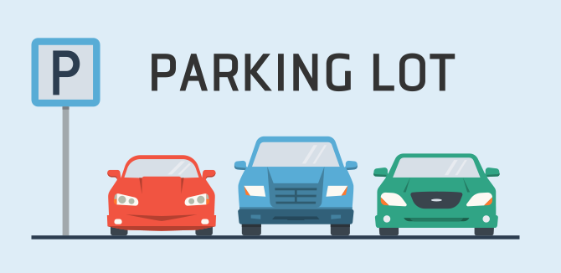
Solution: Parking Lot
LinkedHashSet<String> parkingLot = new LinkedHashSet<>();
while(true)
String input = sc.nextLine();
if (input.equals("END"))
break;
else
String[] reminder = input.split(", ");
if (reminder[0].equals("IN"))
parkingLot.add(reminder[1]);
else
parkingLot.remove(reminder[1]);
Check your solution here: https://judge.softuni.bg/Contests/1462/Sets-And-Maps-Lab

Slide 75
Problem: SoftUni Party
Reservation List
Guests are two types:
Regular
VIPs – their tickets start with digit
Until PARTY command, you will receive guest invitations
Until END command, you will receive a second list with guests that actually cаme to the party
Find how many guests didn't cоme to the party
Print all guests that didn't cоme (VIPs first)
7IK9Yo0h
9NoBUajQ
Ce8vwPmE
SVQXQCbc

Slide 76
Solution: SoftUni Party
Set<String> vip = new TreeSet<>();
Set<String> regular = new TreeSet<>();
String guestId = scanner.nextLine();
while (!guestId.equals("PARTY")) {
if (Character.isDigit(guestId.charAt(0)))
vip.add(guestId);
else
regular.add(guestId);
guestId = scanner.nextLine();
}
//TODO: Remove the guests who came to the party
//TODO: Print results
Return true or false

Slide 77
Problem: "Voina" – Number Game
Create a game that is played by two players:
Each one has 20 unique numbers (read from console, separated with space)
Every round each player bets his first number from deck
Player with bigger number wins and places both numbers at the bottom of his deck
A game ends after 50 rounds or when a player has 0 numbers
Check your solution here: https://judge.softuni.bg/Contests/1462/Sets-And-Maps-Lab

Slide 78
Solution: "Voina" – Number Game
LinkedHashSet<Integer> firstPlayer = getPlayerNumbers();
LinkedHashSet<Integer> secondPlayer = getPlayerNumbers();
for (int i = 0; i < 50; i++) {
int firstNumber = firstPlayer.iterator().next();
firstPlayer.remove(firstNumber);
//TODO: get top number for second player
if (firstNumber > secondNumber) {
firstPlayer.add(firstNumber);
firstPlayer.add(secondNumber);
} else if (secondNumber > firstNumber)
//TODO: finish logic about second player win or draw
}
//TODO: print result

Slide 79
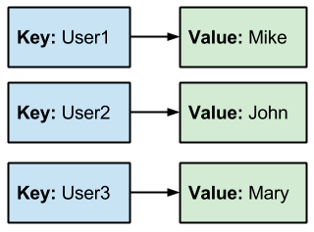
Associative Arrays

Slide 80
Associative Arrays (Maps)
Associative arrays are arrays indexed by keys
Not by the numbers 0, 1, 2, …
Hold a set of pairs <key, value>
Traditional y
Associative array
key
value
key
0 1 2 3 4
John Smith | +1-555-8976
Lisa Smith | +1-555-1234
Sam Doe | +1-555-5030
value
8 | -3 | 12 | 408 | 33

Slide 81
Methods
Initialization
.size()
.isEmpty()
Map<String, Integer> hash = new HashMap<String, Integer>();
Type of keys
Type of values
Map<String, Integer> hash = new HashMap<>();
System.out.println(hash.size()); // 0
System.out.println(hash.isEmpty()); // True

Slide 82
HashMap<K, V> – Put()
HashMap<String, String>
Alice
+359-899-55-592
Pesho
0881-456-987
Gosho
0881-123-987
Hash Function
Put()
Key Value

Slide 83
HashMap<K, V> – Remove()
HashMap<String, String>
Pesho
Hash Function
Remove()
Pesho
0881-123-987
Alice
+359-899-55-592
Key Value

Slide 84
Looping Through Maps – Example
Map<String, Integer> vehicles = new HashMap<>();
vehicles.put("BMW", 5);
vehicles.put("Mercedes", 3);
vehicles.put("Audi", 4);
vehicles.put("BMW", 10);
for(String key: vehicles.keySet())
System.out.println(key + " - " + vehicles.get(key));
Override first value
Return set of all keys
Return value for key
Audi - 4
Mercedes - 3
BMW - 10

Slide 85
Problem: Count Real Numbers
Write a program that counts in a given array of double values the number of occurrences of each value
-2.5 | 4 | 3 | -2.5 | -5.5 | 4 | 3 | 3 | -2.5 | 3
-2.5 -> 3
4.0 -> 2
3.0 -> 4
-5.5 -> 1

Slide 86
Solution: Count Real Numbers
LinkedHashMap<Double, Integer> result = new LinkedHashMap<>();
for (Double number : input) {
if (!result.containsKey(number)) {
result.put(number, 1);
} else {
result.put(number, result.get(number) + 1);
}
}
for (Double key : result.keySet()) {
System.out.println(key + " -> " + result.get(key));
}
Check your solution here: https://judge.softuni.bg/Contests/1462/Sets-And-Maps-Lab

Slide 87
TreeMap<K, V> – Put()
Tree Map<String, String>
Alice
+359-899-55-592
Pesho
0881-123-987
TreeMap Function
Put()
Key Value

Slide 88
Problem: Academy Graduation
Write a program that:
Reads a list of students and their score for some courses
Prints on the console sorted list with average score for each student
Student | Java Advanced | Java OOP
Gosho | 3.75 | 5
Mara | 4.25 | 6
Pesho | 6 | 4.5
Student | Average
Gosho | 4,375
Mara | 5,125
Pesho | 5,25
Check your solution here: https://judge.softuni.bg/Contests/1462/Sets-And-Maps-Lab

Slide 89
Solution: Academy Graduation
TreeMap <String,Double[]> graduationList = new TreeMap<>();
for (int i = 0; i < numberOfStudents; i++) {
String name = scanner.nextLine();
String[] scoresStrings = scanner.nextLine().split(" ");
Double[] scores = new Double[scoresStrings.length];
for (int j = 0; j < scoresStrings.length; j++) {
scores[j] = Double.parseDouble(scoresStrings[j]);
}
graduationList.put(name, scores);
}
//TODO: print results
Check your solution here: https://judge.softuni.bg/Contests/1462/Sets-And-Maps-Lab

Slide 90
HashMap<K, V>, TreeMap<K, V>, LinkedHashMap<K, V>
size() - the number of key-value pairs
keySet() - a set of unique keys
values() - a collection of all values
Basic operations - put(), remove(), clear()
Boolean methods:
containsKey() - checks if a key is present in the Map
containsValue() - checks if a value is present in the Map

Slide 91
Summary
…
…
…
HashSet<E>, TreeSet<E> and LinkedHashSet<E> hold unique elements and are very fast
HashMap<K, V>, TreeMap<K, V> and LinkedHashMap<K, V> are associative arrays where a value is accessed by its key

Slide 92
Files and Streams
Using Streams, Files, Serialization
SoftUni Team
Technical Trainers
Software University
https://softuni.bg

Slide 93
Table of Contents
Streams Basics
Opening a File Stream
Closing a File Stream
Types of Streams
Combining Streams
Files and Directories
Serialization

Slide 94

Streams

Slide 95


What is Stream?
Streams are used to transfer data
We open a stream to:
Read a file
Write to a file
1100 1001 1001
Stream
95

Slide 96

Streams Basics
Two fundamental types of streams:
1100 1001 1001
Input Stream
Streams are unidirectional!
1100 1001 1001
Output Stream

Slide 97
Opening a File Stream
String path = "C:\\input.txt";
FileInputStream fileStream =
new FileInputStream(path);
int oneByte = fileStream.read();
while (oneByte >= 0) {
System.out.print(oneByte);
oneByte = fileStream.read();
}
Returns -1 if empty

Slide 98
Closing a File Stream (1)
Using try-catch-finally
InputStream in = null;
try {
in = new FileInputStream(path);
} catch (IOException e) {
// TODO: handle exception
} finally {
if (in != null) {
in.close();
}
}
close() can also throw an exception
Always free resources!

Slide 99
Closing a File Stream (2)
Using try-with-resources
try (InputStream in = new FileInputStream(path)) {
int oneByte = in.read();
while (oneByte >= 0) {
System.out.print(oneByte);
oneByte = in.read();
}
} catch (IOException e) {
// TODO: handle exception
}

Slide 100
Problem: Read File
You are given a file
Read and print all of its contents as a sequence of bytes
Submit in Judge only the output of the program
Two households, both alike in dignity, In fair Verona, where we lay our scene,
1010100 1110111 1101111 100000 1101000 1101111 1110101 1110011 1100101 1101000…
Check your solution here: https://judge.softuni.bg/Contests/1493/Streams-Files-And-Directories-Lab

Slide 101

Solution: Read File
String path = "D:\\input.txt";
try (InputStream in = new FileInputStream(path)) {
int oneByte = in.read();
while (oneByte >= 0) {
System.out.printf("%s ", Integer.toBinaryString(oneByte));
oneByte = in.read();
}
}
catch (IOException e) {
e.printStackTrace();
}

Slide 102
Problem: Write to File
Read a file and write all its content while skipping any punctuation (skip ',', '.', '!', '?')
Submit in Judge only the output of the program
Two households, both alike in dignity.
In fair Verona, where we lay our scene.
Two households both alike in dignity
In fair Verona where we lay our scene
Check your solution here: https://judge.softuni.bg/Contests/1493/Streams-Files-And-Directories-Lab

Slide 103


Solution: Write to File (1)
String inputPath = "D:\\input.txt";
String outputPath = "D:\\output.txt";
List<Character> symbols = new ArrayList<>();
Collections.addAll(symbols, '.', ',', '!', '?');
// continues…
Check your solution here: https://judge.softuni.bg/Contests/1493/Streams-Files-And-Directories-Lab

Slide 104
Solution: Write to File (2)
try (InputStream in = new FileInputStream(inputPath);
OutputStream out = new FileOutputStream(outputPath)) {
int oneByte = 0;
while ((oneByte = in.read()) >= 0) {
if (!symbols.contains((char)oneByte)) {
out.write(oneByte);
}
}
} // TODO: handle exceptions
Check your solution here: https://judge.softuni.bg/Contests/1493/Streams-Files-And-Directories-Lab

Slide 105

Basic Stream Types in Java
Byte and Character

Slide 106
Byte Stream
Byte streams are the lowest level streams
Byte streams can read or write one byte at a time
All byte streams descend from InputStream and OutputStream
InputStream
100101 | 111111 | 100011 | -1
OutputStream
100101
111111
100011

Slide 107
Problem: Copy Bytes
Read a file and copy its contents to another text file
Write characters as bytes in decimal
Write every space or new line as it is, e.g. as a space or new line
T
w
o
space
Two households, both alike in dignity.
In fair Verona, where we lay our scene.
84119111 10411111711510110411…
73110 10297105114 861011141111109744 1…
Check your solution here: https://judge.softuni.bg/Contests/1493/Streams-Files-And-Directories-Lab

Slide 108
Solution: Copy Bytes
// TODO: Open input and output streams
int oneByte = 0;
while ((oneByte = in.read()) >= 0) {
if (oneByte == 10 || oneByte == 32) {
out.write(oneByte);
} else {
String digits = String.valueOf(oneByte);
for (int i = 0; i < digits.length(); i++)
out.write(digits.charAt(i));
}
} // TODO: handle exceptions
Check your solution here: https://judge.softuni.bg/Contests/1493/Streams-Files-And-Directories-Lab

Slide 109
Character Streams
All character streams descend from FileReader and FileWriter
String path = "D:\\input.txt";
FileReader reader = new FileReader(path);
109

Slide 110
Combining Streams
Character streams are often "wrappers" for byte streams
FileReader uses FileInputStream
FileWriter uses FileOutputStream
String path = "D:\\input.txt";
Scanner reader =
new Scanner(new FileInputStream(path));
Wrapping a Stream

Slide 111
Problem: Extract Integers
Read a file and extracts all integers in a separate file
Get only numbers that are not a part of a word
Submit in Judge only the output of the program
2 households, 22 alike in 3nity, In fair Verona, where we lay our scene
2
22
Check your solution here: https://judge.softuni.bg/Contests/1493/Streams-Files-And-Directories-Lab

Slide 112
Solution: Extract Integers
Scanner scanner =
new Scanner(new FileInputStream(inputPath));
PrintWriter out =
new PrintWriter(new FileOutputStream(outputPath));
while (scanner.hasNext()) {
if (scanner.hasNextInt())
out.println(scanner.nextInt());
scanner.next();
}
out.close();
Check your solution here: https://judge.softuni.bg/Contests/1493/Streams-Files-And-Directories-Lab

Slide 113
Buffered Streams
Reading information in chunks
Significantly boost performance
Length = 9
F i l e s a n d
46 | 69 | 6c | 65 | 73 | 20 | 61 | 6e | 64
Position
Buffer
46 | 69
6c | 65
73 | 20
61 | 6e
64

Slide 114

Problem: Write Every Third Line
Read a file and write all lines which number is divisible by 3 in a separate file
Line numbers start from one
Two households, both alike in dignity, In fair Verona, where we lay our scene, From ancient grudge break to new mutiny…
10101
Check your solution here: https://judge.softuni.bg/Contests/1493/Streams-Files-And-Directories-Lab

Slide 115
Solution: Write Every Third Line
try (BufferedReader in =
new BufferedReader(new FileReader(inputPath));
PrintWriter out =
new PrintWriter(new FileWriter(outputPath))) {
int counter = 1;
String line = in.readLine();
while (line != null) {
if (counter % 3 == 0)
out.println(line);
counter++;
line = in.readLine();
}
} // TODO: handle exceptions
Check your solution here: https://judge.softuni.bg/Contests/1493/Streams-Files-And-Directories-Lab

Slide 116
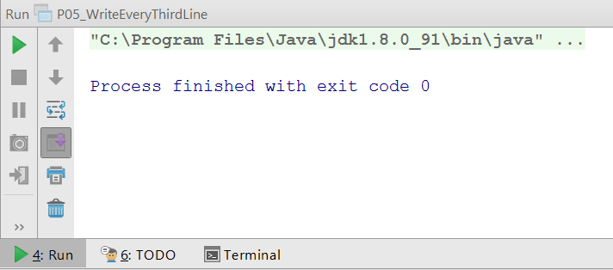
Command Line I/O (1)
Standard Input - System.in
Standard Output - System.out
Standard Error - System.err
Input Stream
Scanner scanner = new Scanner(System.in);
String line = scanner.nextLine();
System.out.println(line);
Output Stream

Slide 117
Command Line I/O (2)
public static void main(String[] args) throws IOException {
BufferedReader reader =
new BufferedReader(new InputStreamReader(System.in));
String hello = reader.readLine(); // Hello BufferedReader
System.out.println(hello); // Hello BufferedReader
}

Slide 118

Files and Paths
Easily Working With Files

Slide 119
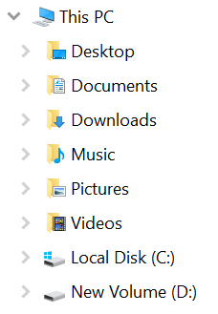
Paths
The location of a file in the file system
Represented in Java by the Path class
D:\input.txt
Path path = Paths.get("D:\\input.txt");
Root folder
D:\
input.txt
other files

Slide 120

Files (1)
Provides static methods for creating streams
Path path = Paths.get("D:\\input.txt");
(BufferedReader reader =
try Files.newBufferedReader(path)) {
// TODO: work with file
} catch (IOException e) {
// TODO: handle exception
}

Slide 121

Files (2)
Provides utility methods for easy file manipulation
Path inPath = Paths.get("D:\\input.txt");
Path outPath = Paths.get("D:\\output.txt");
List<String> lines = Files.readAllLines(inPath);
Files.write(outPath, lines);
// TODO: handle exceptions

Slide 122

Problem: Sort Lines
Read a text file and sort all lines
Write the result to another text file
Use Paths and Files classes
C
A
B
D
…
A
B
C
D
…
Check your solution here: https://judge.softuni.bg/Contests/1493/Streams-Files-And-Directories-Lab

Slide 123
Solution: Sort Lines
Path path = Paths.get("D:\\input.txt");
Path output = Paths.get("D:\\output.txt");
try {
List<String> lines = Files.readAllLines(path);
lines = lines.stream().filter(l ->
!l.isBlank()).collect(Collectors.toList());
Collections.sort(lines);
Files.write(output, lines);
} catch (IOException e) {
e.printStackTrace();
}
Don't use for large files
Check your solution here: https://judge.softuni.bg/Contests/1493/Streams-Files-And-Directories-Lab

Slide 124

File Class in Java
Easily Working With Files

Slide 125

File Class in Java
Provides methods for quick and easy manipulation of files
import java.io.File;
File file = new File("D:\\input.txt");
boolean isExisting = file.exists();
long length = file.length();
boolean isDirectory = file.isDirectory();
File[] files = file.listFiles();

Slide 126

Problem: List Files
Print names and sizes of all files in "Files-and-Streams" directory
Skip child directories
input.txt: [size in bytes]
output.txt: [size in bytes]
Check your solution here: https://judge.softuni.bg/Contests/1493/Streams-Files-And-Directories-Lab

Slide 127

Solution: List Files
if (file.exists()) {
if (file.isDirectory()) {
File[] files = file.listFiles();
for (File f : files) {
if (!f.isDirectory()) {
System.out.printf("%s: [%s]%n",
f.getName(), f.length());
}
}
}
}

Slide 128
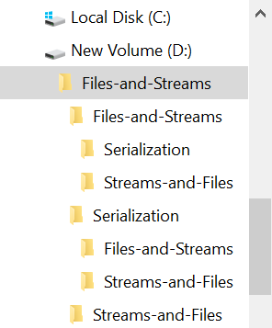
Problem: Nested Folders
You are given a folder named "Files-and-Streams"
List all folder names, starting with the root
Print folder count on the last line (including the root)
…
Streams-and-Files
Serialization
Streams-and-Files
[count] folders
Check your solution here: https://judge.softuni.bg/Contests/1493/Streams-Files-And-Directories-Lab

Slide 129
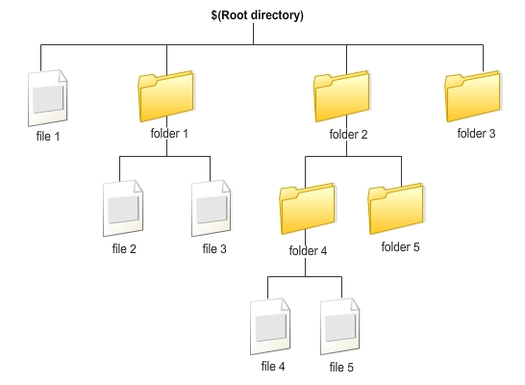
Solution: Nested Folders (1)
String path = "D:\\Files-and-Streams";
File root = new File(path);
Deque<File> dirs = new ArrayDeque<>();
dirs.offer(root);
// continue…
Check your solution here: https://judge.softuni.bg/Contests/1493/Streams-Files-And-Directories-Lab

Slide 130
Solution: Nested Folders (2)
int count = 0;
while (!dirs.isEmpty()) {
File current = dirs.poll();
File[] nestedFiles = current.listFiles();
for (File nestedFile : nestedFiles)
if (nestedFile.isDirectory())
dirs.offer(nestedFile);
count++;
System.out.println(current.getName());
}
System.out.println(count + " folders");
Check your solution here: https://judge.softuni.bg/Contests/1493/Streams-Files-And-Directories-Lab

Slide 131



Serialization
Serializing and Deserializing Objects

Slide 132
Serialization
Save objects to a file
List<String> names = new ArrayList<>();
Collections.addAll(names, "Mimi", "Gosho");
FileOutputStream fos = new FileOutputStream(path);
ObjectOutputStream oos =
new ObjectOutputStream(fos);
oos.writeObject(names);
// TODO: handle exceptions
Save objects to .ser file

Slide 133
Deserialization
Load objects from a file
FileInputStream fis =
new FileInputStream(path);
ObjectInputStream oos =
new ObjectInputStream(fis);
List<String> names =
(List<String>) oos.readObject();
// TODO: handle exceptions

Slide 134

Serialization of Custom Objects
Custom objects should implement the Serializable interface
class Cube implements Serializable {
String color;
double width;
double height;
double depth;
}

Slide 135
Problem: Serialize Custom Object
Create a Cube class with color, width, height and depth
Create a cube – color: "green", w: 15.3, h: 12.4 and d: 3
Check your solution here: https://judge.softuni.bg/Contests/1493/Streams-Files-And-Directories-Lab

Slide 136
Solution: Serialize Custom Object (1)
class Cube implements Serializable {
String color;
double width;
double height;
double depth;
}
Check your solution here: https://judge.softuni.bg/Contests/1493/Streams-Files-And-Directories-Lab

Slide 137
Solution: Serialize Custom Object (2)
//TODO: Create Cube object
String path = "D:\\save.ser";
try (ObjectOutputStream oos = new ObjectOutputStream(
new FileOutputStream(path))) {
oos.writeObject(cube);
} catch (IOException e) {
e.printStackTrace();
}
Check your solution here: https://judge.softuni.bg/Contests/1493/Streams-Files-And-Directories-Lab

Slide 138
Summary
…
…
…
Streams are used to transfer data
Two main types of streams
Input Streams
Output Streams
Buffered streams boost performance
Streams can be chained together
You can save objects state into a file

Slide 139

Functional Programming
Functions and Lambda Expressions
SoftUni Team
Technical Trainers
Software University
https://softuni.bg

Slide 140
Table of Contents
Lambda Expressions
What Is a Function?
Function<T,R>
Other Function Types
Consumer<T>
Supplier<T>
Predicate<T>
BiFunction<T, U, R>
Passing Functions to Methods

Slide 141

Lambda Expressions

Slide 142
What is a Function?
Mathematic function
f(x) = x²
x
f(x)
Name
3 | 9
1 | 1
0 | 0
4 | 16
-4 | 16
Input
Output
A function is a special relationship where each input has a single output

Slide 143
Lambda Expressions (1)
Lambda expression - unnamed function
Has parameters and a body
Use the lambda operator -> Read as "goes to"
Lambda Syntax
(parameters) -> {body}

Slide 144
Lambda Expressions (2)
Implicit lambda expression
Explicit lambda expression
(msg) -> { System.out.println(msg); }
Parameters can be enclosed in parentheses ()
The body can be enclosed in braces {}
String msg -> System.out.println(msg);
Declares parameters' type

Slide 145
Lambda Expressions (3)
Can have different number of parameters:
Zero parameters
More parameters
() -> { System.out.println("Hello!"); }
() -> { System.out.println("How are you?"); }
(int x, int y) -> { return x + y; }
(int x, int y, int z) -> { return (y - x) * z; }

Slide 146


Problem: Sort Even Numbers
Read Integers from the console
Print the even numbers
Sort the even numbers
Print the sorted numbers
4, 2, 1, 3, 5, 7, 1, 4, 2, 12
4, 2, 4, 2, 12
2, 2, 4, 4, 12
Check your solution here: https://judge.softuni.bg/Contests/1513/Functional-Programming-Lab

Slide 147
Solution: Sort Even Numbers
//TODO: Read numbers and parse them to List Of Integers
numbers.removeIf(n -> n % 2 != 0);
// TODO: Print the even numbers
numbers.sort((a, b) -> a.compareTo(b));
//TODO: Print the sorted numbers
Check your solution here: https://judge.softuni.bg/Contests/1513/Functional-Programming-Lab

Slide 148
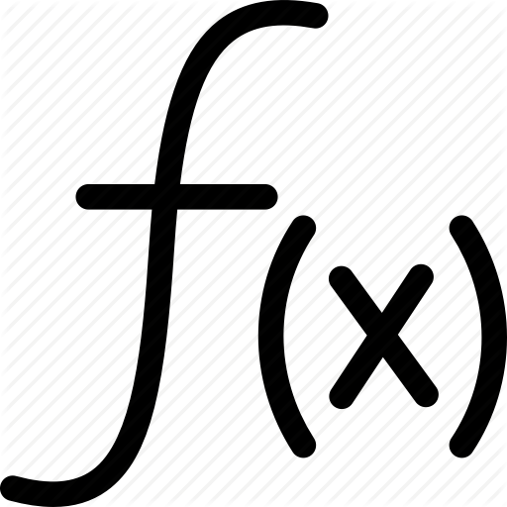
Functions
Mathematical and Java Functions

Slide 149
Java Functions
In Java we can create functions analogical to mathematical functions
f(x) = x²
Return Expression
Output Type
Input Parameter
Function<Integer, Integer> func = x -> x * x;
Input Type
Name
Lambda Expression

Slide 150
Function<T, R>
In Java Function<T,R> is an interface that accepts a parameter of type T and returns variable of type R
We use function with .apply()
int increment(int number) {
return number + 1;
}
Function<Integer, Integer> increment =
number -> number + 1;
int a = increment.apply(5);
int b = increment.apply(a);

Slide 151

Problem: Sum Numbers
Read numbers from the console
Print their count
Print their sum
Use a Function
4, 2, 1, 3, 5, 7, 1, 4, 2, 12
Count = 10
Sum = 41
Check your solution here: https://judge.softuni.bg/Contests/1513/Functional-Programming-Lab

Slide 152
Solution: Sum Numbers
// TODO: Read input
if (input.length < 2) {
System.out.println("Count = " + input.length);
System.out.println("Sum = " + input[0]);
} else {
Function<String, Integer> parser = x -> Integer.parseInt(x);
int sum = 0;
for (String s : input) sum += parser.apply(s);
// TODO: Print output
}
Check your solution here: https://judge.softuni.bg/Contests/1513/Functional-Programming-Lab
152

Slide 153

Other Function Types
Special Functions

Slide 154
Consumer<T>
In Java Consumer<T> is a void interface:
We use a Consumer with .accept():
void print(String message) {
System.out.println(message);
}
Consumer<String> print =
message -> System.out.print(message);
print.accept("Peter");

Slide 155
Supplier<T>
In Java Supplier<T> takes no parameters:
We use a Supplier with .get():
int genRandomInt() {
Random rnd = new Random();
return rnd.nextInt(51);
}
Supplier<Integer> genRandomInt =
() -> new Random().nextInt(51);
int rnd = genRandomInt.get();

Slide 156
Predicate<T>
In Java Predicate<T> evaluates a condition:
We use the Predicate with .test():
boolean isEven(int number) {
return number % 2 == 0;
}
Predicate<Integer> isEven =
number -> number % 2 == 0;
System.out.println(isEven.test(6)); // true

Slide 157

Problem: Count Uppercase Words
Read text from the console
Find the words starting with an Uppercase letter
Print the count and the words
Use a Predicate
The following example shows how to use Predicate
2
The
Predicate
Check your solution here: https://judge.softuni.bg/Contests/1513/Functional-Programming-Lab

Slide 158
Solution: Count Uppercase Words
// TODO: Read text
Predicate<String> checkerUpperCase =
word -> Character.isUpperCase(word.charAt(0));
ArrayList<String> result = new ArrayList<>();
for (int i = 0; i < textAsList.length; i++) {
if (checkerUpperCase.test(textAsList[i]))
result.add(textAsList[i]);
}
// TODO: Print results
Check your solution here: https://judge.softuni.bg/Contests/1513/Functional-Programming-Lab
158

Slide 159

Problem: Add VAT
Read some items' prices from the console
Add VAT of 20% to all of them
1.38, 2.56, 4.4
Prices with VAT:
1,66
3,07
5,28
Check your solution here: https://judge.softuni.bg/Contests/1513/Functional-Programming-Lab

Slide 160
Solution: Add VAT
// TODO: Read input
List<Double> numbers = new ArrayList<>();
for (String s : input)
numbers.add(Double.parseDouble(s));
UnaryOperator<Double> addVat = x -> x * 1.2;
System.out.println("Prices with VAT:");
for (Double str : numbers)
System.out.println(String.format("%1$.2f",
addVat.apply(str)));
Check your solution here: https://judge.softuni.bg/Contests/1513/Functional-Programming-Lab
160

Slide 161

Bi Functions
Using Functions With More Parameters

Slide 162

BiFunctions
BiFunction <T, U, R>
Analogically you can use:
BiConsumer <T, U>
BiPredicate <T, U>
BiFunction <Integer, Integer, String> sum = (x, y) -> "Sum is" + (x + y);
Two input parameters

Slide 163
Problem: Sum Numbers
Read numbers from the console
Print their count
Print their sum
Use BiFunctions
4, 2, 1, 3, 5, 7, 1, 4, 2, 12
Count = 10
Sum = 41
Check your solution here: https://judge.softuni.bg/Contests/1513/Functional-Programming-Lab

Slide 164
Solution: Sum Numbers
// TODO: Read input
int length = input.length;
int sum = Integer.parseInt(input[0]);
if (input.length >= 2) {
BiFunction<Integer, String, Integer> parser =
(x, y) -> x + Integer.parseInt(y);
for (int i = 1; i < input.length; i++)
sum = parser.apply(sum, input[i]);
}
// TODO: Print output
Check your solution here: https://judge.softuni.bg/Contests/1513/Functional-Programming-Lab
164

Slide 165
Passing Functions to Method
We can pass Function<T,R> to methods:
We can use the method like that:
static int operation(int number, Function<Integer, Integer> function) {
return function.apply(number);
}
int a = 5;
int b = operation(a, number -> number * 5); // b = 25
int c = operation(a, number -> number - 3); // c = 2
int d = operation(b, number -> number % 2); // d = 1

Slide 166
Problem: Filter by Age
Read from console n people with their age
Read a condition and an age so to filter them
Read format type for the output
Print all people that fulfill the condition
Peter | 20
George | 18
Raddy | 29
Maria | 32
Ivan | 16
Peter | 20
Raddy | 29
Maria | 32
Condition - "older"
Age - 20
Format - "name age"

Slide 167
Solution: Filter by Age (1)
//TODO: Read info from the console
Predicate<Integer> tester = createTester(condition, age);
Consumer<Map.Entry<String, Integer>> printer =
createPrinter(format);
printFilteredStudent(people, tester, printer);
Check your solution here: https://judge.softuni.bg/Contests/1513/Functional-Programming-Lab
167

Slide 168
Solution: Filter by Age (2)
static Consumer<Map.Entry<String, Integer>> createPrinter(String format) {
Consumer<Map.Entry<String, Integer>> printer = null;
switch (format) {
case "name age":
printer = person -> System.out.printf("%s - %d%n",
person.getKey(), person.getValue());
break; //TODO: Add more cases
}
return printer;
}
Check your solution here: https://judge.softuni.bg/Contests/1513/Functional-Programming-Lab
168

Slide 169
Solution: Filter by Age (3)
static Predicate<Integer> createTester(String condition, Integer age) {
Predicate<Integer> tester = null;
switch (condition) {
case "younger":
tester = x -> x <= age;
break; //TODO: Add more cases
}
return tester;
}
Check your solution here: https://judge.softuni.bg/Contests/1513/Functional-Programming-Lab
169

Slide 170
Solution: Filter by Age (4)
static void printFilteredStudent(
LinkedHashMap<String, Integer> people,
Predicate<Integer> tester,
Consumer<Map.Entry<String, Integer>> printer) {
for (Map.Entry<String, Integer> person : people.entrySet()) {
if (tester.test(people.get(person.getKey())))
printer.accept(person);
}
}
Check your solution here: https://judge.softuni.bg/Contests/1513/Functional-Programming-Lab
170

Slide 171
Summary
…
…
…
Lambda expressions are anonymous methods
Function<T,R> is a function that returns R type
Consumer<T> is a void function
Supplier<T> gets no parameters
Predicate<T> evaluates a condition
BiFunction<T, U, R> accepts two parameters
Functions can be passed like variables to methods

Slide 172

Defining Classes
Classes, Fields, Constructors, Methods
SoftUni Team
Technical Trainers
Software University
https://softuni.bg

Slide 173

Table of Contents
Defining Simple Classes
Fields
Methods
Constructors, Keyword this
Static Members

Slide 174

Defining Classes

Slide 175
Defining Simple Classes
Specification of a given type of objects from the real-world
Classes provide structure for describing and creating objects
Class name
Keyword
class Car {
…
}
Class body
175

Slide 176


Naming Classes
Use PascalCase naming
Use descriptive nouns
Avoid ambiguous names
class Dice { … }
class BankAccount { … }
class IntegerCalculator { … }
class TPMF { … }
class bankaccount { … }
class numcalc { … }
176

Slide 177
Class Members
Class is made up of state and behavior
Fields store state
Methods describe behaviour
class Car {
String brand;
String model;
void start(){ … }
}
class Dog {
int age;
String type;
void bark(){ … }
}
Fields
Fields
Method
Method
177

Slide 178

Creating an Object
A class can have many instances (objects)
class Program {
public static void main() {
Car firstCar = new Car();
Car secondCar = new Car();
}
}
Variable stores a reference
Use the new keyword
178

Slide 179
Object Reference
Declaring a variable creates a reference in the stack
The new keyword allocates memory on the heap
Car car = new Car();
STACK
HEAP
obj
diceD6
(1540e19d)
type = null
sides = 0
179

Slide 180
Classes vs. Objects
Classes provide structure for creating objects
An object is a single instance of a class
class
Dice
object D6Dice
Object name
Class name
sides: int
sides = 6
Class fields
Object data
roll(…)
Class actions (methods)
180

Slide 181

Class Data

Slide 182
Fields
Class fields have access modifiers, type and name
public class Car {
private String brand;
private int year;
public Person owner;
…
}
type
access modifier
name
Fields can be of any type
182

Slide 183
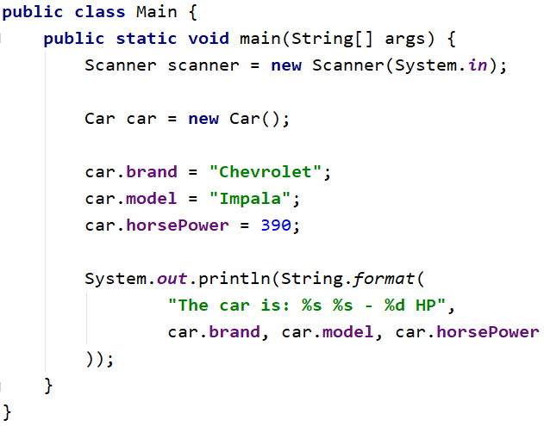
Problem: Define Car Class
Create a class Car
Ensure proper naming!
Car
Class name
+brand:String
+model:String
+horsePower:int
Class fields
(no actions)
Class methods

Slide 184
Solution: Define Car Class
public class Car {
String brand;
String model;
int horsePower;
}

Slide 185
Access Modifiers
Classes and class members have modifiers
Modifiers define visibility
Class modifier
public class Car {
private String brand;
private String model;
}
Fields should always be private!
Member modifier

Slide 186

Methods

Slide 187
Methods
Store executable code (algorithm) that manipulate state
class Car {
private int horsePower;
public void increaseHP(int value) {
horsePower += value;
}
}

Slide 188
Getters and Setters
Used to create accessors and mutators (getters and setters)
Field is hidden
class Car {
private int horsePower;
public int getHorsePower() {
return this.horsePower;
}
public void setHorsePower(int horsePower) {
this.horsePower = horsePower;
}
}
Getter provides access to field
this points to the current instance
Setter provide field change

Slide 189
Getters and Setters
Keyword this
Prevent field hiding
Refers to a current object
private int horsePower;
public void setSides(int horsePower) {
this.horsePower = horsePower;
}
public void setSidesNotWorking(int horsePower) {
horsePower = horsePower;
}

Slide 190
ToString() Method
We can use toString() method to get String representation of an object.
Whenever we try to print the Object reference then internally toString() method is invoked.
If we did not define toString() method in your class then Object class toString()
Car car = new Car();
System.out.println(car); //Car@3feba861
190

Slide 191
ToString() Method
If you define toString() method in your class then your implemented/Overridden toString() method will be called..
public class Car {
…
@Override
public String toString() {
return this.brand + ":" + this.model;
}
}
Car car = new Car();
System.out.println(car); //BMW:M3
191

Slide 192
Equals() Method
In java equals() method is used to compare equality of two Objects
Car firstCar = new Car("BMW","M3");
Car secondCar = new Car("Mercedes","C63 AMG");
boolean isEqual = firstCar.equals(secondCar);
System.out.println(isEqual); //false
192

Slide 193
HashCode() Method
Method returns the hash code for the Method class object.
The hash code is always the same if the object doesn’t change.
Syntax:
Car car = new Car();
int hash = car.hashCode(); //integer value which represents hashCode value for this class.
System.out.println(hash); //1072408673
193

Slide 194
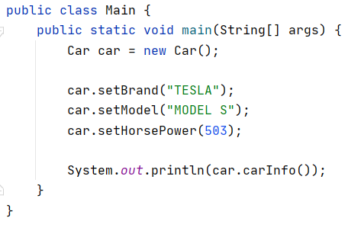
Problem: Car Info
Create a class Car
- == private
Car
-brand:String
…
return type
+setBrand():void
+getBrand():String
…
+carInfo():String
+ == public
Check your solution here: https://judge.softuni.bg/Contests/1517/Defining-Classes-Lab

Slide 195
Solution: Car Info
public class Car {
private String brand;
private String model;
private int horsePower;
public void setBrand(String brand) { this.brand = brand; }
public String getBrand() { return this.brand; }
public String carInfo() {
return String.format("The car is: %s %s - %d HP.",
this.brand, this.model, this.horsePower);
}
//TODO: Create the other Getters and Setters
}
//TODO: Test the program
Check your solution here: https://judge.softuni.bg/Contests/1517/Defining-Classes-Lab

Slide 196

Constructors

Slide 197
Constructors
Special methods, executed during object creation
The only one way to call a constructor in Java is through the keyword new
public class Car {
private String brand;
public Car() {
this.brand = "BMW";
}
}
Overloading default constructor
197

Slide 198
Constructors (1)
Special methods, executed during object creation
class Car {
private String brand;
…
public Car() {
this.brand = "unknown";
…
}
}
Overloading default constructor

Slide 199
Constructors (2)
You can have multiple constructors in the same class
public class Car {
private int horsePower; private String brand;
public Car(String brand) {
this.brand = brand;
}
public Car(String brand, int horsePower) {
this.brand = brand;
this.horsePower = horsePower;
}
}
Constructor with one parameter
Constructor with all parameters

Slide 200
Object Initial State
Constructors set object's initial state
public class Car {
String brand;
List<Part> parts;
public Car(String brand) {
this.brand = brand;
this.parts = new ArrayList<>();
}
}
Always ensure correct state

Slide 201
Constructor Chaining
Constructors can call each other
class Car {
private String brand;
private int horsePower;
public Car(String brand, int horsePower) {
this.brand = brand;
this.horsePower = horsePower;
}
public Car(String brand) {
this(brand, -1);
}
}

Slide 202
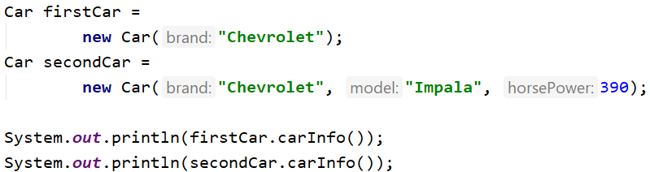
Problem: Constructors
Create a class Car
Car
-brand:String
-model:String
-horsePower:int
+Car(String brand)
+Car(String brand, String model, int horsePower)
+carInfo():String
Check your solution here: https://judge.softuni.bg/Contests/1517/Defining-Classes-Lab

Slide 203
Solution: Constructors
public Car(String brand) {
this.brand = brand;
this.model = "unknown";
this.horsePower = -1;
}
public Car(String brand, String model, int horsePower) {
this(brand);
this.model = model;
this.horsePower = horsePower;
}
Check your solution here: https://judge.softuni.bg/Contests/1517/Defining-Classes-Lab

Slide 204

Static Members

Slide 205
Static Members
Access static members through the class name
Static members are shared class-wide
You don't need an instance
class Program {
public static void main(String[] args) {
BankAccount.setInterestRate(2.2);
}
}
Sets the rate for all bank accounts
205

Slide 206
Static Members
class BankAccount {
private static int accountsCount;
private static double interestRate;
public BankAccount() {
accountsCount++;
}
public static void setInterestRate(double rate) {
interestRate = rate;
}
}

Slide 207
Problem: Bank Account
BankAccount
Create a class BankAccount
Support commands:
Create
Deposit {ID} {Amount}
SetInterest {Interest}
GetInterest {ID} {Years}
End
-id:int (starts from 1)
-balance:double
-interestRate:double (default: 0.02)
underline == static
+setInterest(double interest):void
+getId():int
+getInterest(int years):double
+deposit(double amount):void
Create
Deposit 1 20
GetInterest 1 10
End
Account ID1 Created
Deposited 20 to ID1
4.00
(20 * 0.02) * 10

Slide 208
Solution: Bank Account
public class BankAccount {
private final static double DEFAULT_INTEREST = 0.02;
private static double rate = DEFAULT_INTEREST;
private static int bankAccountsCount;
private int id;
private double balance;
// continue…
Check your solution here: https://judge.softuni.bg/Contests/1517/Defining-Classes-Lab

Slide 209
Solution: Bank Account (2)
public BankAccount() {
this.id = ++bankAccountsCount;
}
public static void setInterest(double interest) {
rate = interest;
}
// TODO: int getId()
// TODO: double getInterest(int years)
// TODO: void deposit(double amount)
// TODO: override toString()
}
Check your solution here: https://judge.softuni.bg/Contests/1517/Defining-Classes-Lab

Slide 210
Solution: Bank Account (2)
HashMap<Integer, BankAccount> bankAccounts = new HashMap<>();
while (!command.equals("End")) {
//TODO: Get command args
switch (cmdType) {
case "Create": // TODO
case "Deposit": // TODO
case "SetInterest": // TODO
case "GetInterest": // TODO
}
//TODO: Read command
}
Check your solution here: https://judge.softuni.bg/Contests/1517/Defining-Classes-Lab

Slide 211
Summary
…
…
…
Classes define specific structure for objects
Objects are particular instances of a class
Classes define fields, methods, constructors and other members
Constructors are invoked when creating new class instances
Constructors initialize the object's initial state

Slide 212

Generics
Adding Type Safety and Code Reusability
SoftUni Team
Technical Trainers
Software University
https://softuni.bg

Slide 213
Table of Contents
The Problem before Java 5.0
Generics Syntax
Generic Classes and Interfaces
Generic Methods
Type Erasure, Type Parameter Bounds

Slide 214

Generics
The Problem and the Solution

Slide 215
The Problem Before Java 5.0
We need a collection that will store only strings
List strings = new ArrayList();
strings.add("1");
strings.add("2");
strings.add(3); // Is this correct?
String e1 = (String) strings.get(0);
String e2 = (String) strings.get(1);
String e3 = (String) strings.get(2); // RTE

Slide 216
Generics - Type Safety
We need a collection that will store only strings
Adds type safety and provides powerful way for code reuse
List<String> strings = new ArrayList<String>();
strings.add("1");
strings.add("2");
strings.add(3); // Compile time error
List<Integer> integers = new ArrayList<>();
List<Person> people = new ArrayList<>();
Type Inference

Slide 217
Generic Classes
Defined with <Type Parameter 1, Type Parameter 2 … etc.>
Multiple Type Parameters
class ArrayList<T> {
/* magic */
}
class HashMap<K, V> {
/* magic */
}

Slide 218
Type Parameter Scope
You can use it anywhere inside the declaring class
class List<T> {
public void add (T element) {…}
public T remove () {…}
public T get(int index) {…}
}

Slide 219
Problem: Jar of T
Create a class Jar<> that can store anything
Adding should add on top of its contents
Remove should get the topmost element
It should have two public methods:
void add(element)
element remove()
Check your solution here: https://judge.softuni.bg/Contests/1526/Generics-Lab

Slide 220
Solution: Jar of T
public class Jar<T> {
private Deque<T> content;
public Jar() { this.content = new ArrayDeque<>(); }
public void add(T entity) {
this.content.push(entity);
}
public T remove() { return this.content.pop(); }
}
Check your solution here: https://judge.softuni.bg/Contests/1526/Generics-Lab

Slide 221
Subclassing Generic Classes
Can extend to a concrete class
class JarOfPickles extends Jar<Pickle> {
…
}
JarOfPickles jar = new JarOfPickles();
jar.add(new Pickle());
jar.add(new Vegetable()); // Error

Slide 222
Generic Interfaces
Generic interfaces are similar to generic classes
interface List<T> {
void add (T element);
T get (int index);
…
}
class MyList implements List<MyClass> {…}
class MyList<T> implements List<T> {…}

Slide 223
Problem: Generic Array Creator
Create a class ArrayCreator with a single method:
static T[] create(int length, T item)
Add a single overload:
static T[] create(Class<T> class, int length, T item)
It should return an array
with the given length
every element should be set to the given default item
Check your solution here: https://judge.softuni.bg/Contests/1526/Generics-Lab

Slide 224
Solution: Generic Array Creator (1)
public static <T> T[] create(int length, T item) {
T[] array = (T[]) new Object[length];
for (int i = 0; i < array.length; i++) {
array[i] = item;
}
return array;
}
Check your solution here: https://judge.softuni.bg/Contests/1526/Generics-Lab

Slide 225
Solution: Generic Array Creator (2)
public static <T> T[] create(
Class<T> cl, int length, T item) {
T[] array = (T[]) Array.newInstance(cl, length);
for (int i = 0; i < array.length; i++) {
array[i] = item;
}
return array;
}
Check your solution here: https://judge.softuni.bg/Contests/1526/Generics-Lab

Slide 226
Type Erasure
Generics are compile time illusion
Compiler deletes all angle bracket syntax
Adds type casts for us (presented in byte-code)
List<String> strings = new ArrayList<String>();
System.out.println(strings instanceof List);
System.out.println(
strings instanceof List<String>); // CTE

Slide 227
Type Erasure – Example
public class Illusion<T> {
public void function(Object obj) {
if (obj instanceof T) {} // Error
T[] array = new T[1]; // Error
T newInstance = new T(); // Error
Class cl = T.class; // Error
}
}

Slide 228

Type Parameter Bounds
Upper and Lower Bounds

Slide 229
Type Parameter Bounds
<T extends Class> - specifies an "Upper bound"
class AnimalList<T extends Animal> {
private List<T> animals;
void add (T animal) {…}
void putAnimalsToSleep() {
for (Animal a : this.animals)
a.sleep();
}
}
T will be a subclass of Animal
Uses methods of T

Slide 230

Problem: Generic Scale
Create a class Scale<T> that:
Holds two elements: left and right
Receives the elements through its single constructor:
Scale(T left, T right)
Has a method: T getHeavier()
The greater of the two elements is heavier
Should return null if the elements are equal
Check your solution here: https://judge.softuni.bg/Contests/1526/Generics-Lab

Slide 231
Solution: Generic Scale (1)
public class Scale<T extends Comparable<T>> {
private T left;
private T right;
public Scale(T left, T right) {
this.left = left;
this.right = right;
}
public T getHeavier() { /* next slide */ } }
Check your solution here: https://judge.softuni.bg/Contests/1526/Generics-Lab

Slide 232
Solution: Generic Scale (2)
public T getHeavier() {
if (this.left.compareTo(this.right) == 0)
return null;
if (this.left.compareTo(this.right) < 0)
return right;
return left;
}
Check your solution here: https://judge.softuni.bg/Contests/1526/Generics-Lab

Slide 233

Problem: List Utilities
Create a class ListUtils that:
Has two static methods:
T getMin(List<T> list)
T getMax(List<T> list)
Should throw IllegalArgumentException if an empty list is passed
Check your solution here: https://judge.softuni.bg/Contests/1526/Generics-Lab

Slide 234
Solution: List Utilities
public static <T extends Comparable<T>> T getMax(List<T> list) {
if (list.size() == 0) throw new IllegalArgumentException();
T max = list.get(0);
for (int i = 1; i < list.size(); i++) {
if (max.compareTo(list.get(i)) < 0)
max = list.get(i);
}
return max;
}
Check your solution here: https://judge.softuni.bg/Contests/1526/Generics-Lab

Slide 235
Type Parameters Relationships (1)
Generics are invariant
If the above was possible, then why not:
List<Object> objects = new ArrayList<>();
List<Animal> animals = new ArrayList<>();
objects = animals; // Compile Time Error!
objects = animals;
objects.add(new Person()); // Impossible!

Slide 236
Type Parameters Relationships (2)
List<Object> can hold any Object
Object
List<Animal> can hold any Animal
Person
Animal
Cat
Dog
List<Object> ≠ List<Animal>

Slide 237
Summary
…
…
…
Generics add type safety
Generic code is more reusable
Classes, interfaces and methods can be generic
Runtime information about type parameters is lost due to erasure

Slide 238


Iterators and Comparators
SoftUni Team
Technical Trainers
Software University
https://softuni.bg

Slide 239
Table of Contents
Variable Arguments
Iterators
Iterator
ListIterator
Comparators
Comparable

Slide 240
Variable Arguments
args...

Slide 241
Variable Arguments (Varargs)
Allows the method to accept zero or multiple arguments
Ellipsis syntax
static void display(String... values) {
System.out.println("display method invoked");
}
static void main() {
display();
display("first");
display("multiple", "Strings");
}

Slide 242
Variable Arguments Rules
There can be only one variable argument in the method
Variable argument must be the last argument
static void display(int num, String... values) {
System.out.println("display method invoked");
}
void method(String... a, int... b){} //Compile time error
void method(int... a, String b){} //Compile time error

Slide 243
Problem: Book
Create a class Book, which has:
Title
Year
Authors
Use only one constructor for Book
There can be no authors, one author or many authors
Book
-title: String
-year: int
-authors: List<String>
-setTitle(String)
-setAuthors(String…)
-setYear(int)
+getTitle(): String
+getYear(): int
+getAuthors(): List<String>
Check your solution here: https://judge.softuni.bg/Contests/1542/Iterators-and-Comparators-Lab

Slide 244

Solution: Book (1)
//TODO: Add fields
public Book(String title, int year, String... authors) {
this.setTitle(title);
this.setYear(year);
this.setAuthors(authors);
}
Check your solution here: https://judge.softuni.bg/Contests/1542/Iterators-and-Comparators-Lab

Slide 245
Solution: Book (2)
//TODO: Add all other getters and setters
private void setAuthors(String... authors) {
if (authors.length == 0) {
this.authors = new ArrayList<String>();
} else {
this.authors = new ArrayList<>(Arrays.asList(authors));
}
}
Check your solution here: https://judge.softuni.bg/Contests/1542/Iterators-and-Comparators-Lab

Slide 246

Iterable<T> and Iterator<T>

Slide 247
Collections Hierarchy
Inheritance leads to hierarchies of classes and/or interfaces in an application:
Iterable
Map
Collection
SortedMap
List
Set
Queue
NavigableMap
SortedSet
Deque

Slide 248
Iterable<T>
Root interface of the Java collection classes
A class that implements the Iterable<T> can be used with the new for loop
List list = new ArrayList();
for(Object o : list) {
// do something o;
}
248

Slide 249
Iterable<T> Methods
Abstract methods
iterator()
Default methods
forEach(Consumer<? super T> action)
spliterator() - used for parallel programming
public interface Iterable<T> {
public Iterator<T> iterator();
}

Slide 250


Iterator<T>
Enables you to cycle through a collection
Nested class for Iterator<T>
Don't implement both Iterable<T> and Iterator<T>
public class Library<T> implements Iterable<T> {
private final class LibIterator implements Iterator<T> {}
}
class MyClass implements Iterable<T>, Iterator<T> {}
250

Slide 251
Problem: Library
Create a class Library, which implements Iterable<Book>
Create nested class LibIterator, which implements Iterator<Book>
<<Iterator<Book>>>
LibIterator
<<Iterable<Book>>>
Library
-counter: int
-books: Book[]
+hasNext(): Boolean
+next(): Book
+iterator(): Iterator<Book>
Check your solution here: https://judge.softuni.bg/Contests/1542/Iterators-and-Comparators-Lab

Slide 252
Solution: Library (1)
public class Library<Book> implements Iterable<Book> {
private Book[] books;
public Library(Book... books) {
this.books = books;
}
public Iterator<Book> iterator() {
return new LibIterator();
}
//TODO: Add nested iterator, look for it on next slide
}
Check your solution here: https://judge.softuni.bg/Contests/1542/Iterators-and-Comparators-Lab

Slide 253
Solution: Library (2)
private final class LibIterator implements Iterator<Book> {
private int counter = 0;
public boolean hasNext() {
if(this.counter < books.length) { return true; }
return false;
}
public Book next() { return books[counter++]; }
}
Check your solution here: https://judge.softuni.bg/Contests/1542/Iterators-and-Comparators-Lab

Slide 254

Comparable<T> and Comparator<T>

Slide 255
Comparator<E>
Comparator provides a way for you to provide custom comparison logic for types that you have no control over
Multiple sorting sequence
Doesn’t affect the original class
compare() method
255

Slide 256
Comparable<E>
Comparable allows you to specify how objects that you are implementing get compared
Single sorting sequence
Affects the original class
compareTo() method
256

Slide 257
Comparable<E>
Allows you to specify how objects that you are implementing get compared
class Student implements Comparable<Student> {
private String name; private int age;
public int compareTo(Student st) {
if (this.age == st.age) { return 0; }
else if (this.age > st.age) { return 1; }
else if (this.age < st.age) { return -1; }
}
}
Provide data type of compared object

Slide 258
Comparator<E>
Allows you to provide custom comparison logic:
class Dog implements Comparator<Dog>{
private String name;
private int age;
public int compare(Dog d, Dog d1) {
return d.age - d1.age;
}
}

Slide 259
Problem: Comparable Book
Expand Book by implementing
Comparable<Book>
Book has to be compared by title
When title is equal, compare them by year
<<Comparable<Book>>> Book
-title: String
-year: int
-authors: List<String>
-setTitle(String)
-setYear(String)
-setAuthors(String…)
+getTitle(): String
+getYear(): int
+getAuthors(): +List<String>
+compareTo(Book): int
Check your solution here: https://judge.softuni.bg/Contests/1542/Iterators-and-Comparators-Lab

Slide 260
Solution: Comparable Book
public int compareTo(Book book) {
if (this.getTitle().compareTo(book.getTitle()) == 0) {
if (this.getYear() > book.getYear()) { return 1;}
else if (this.getYear() < book.getYear()) { return -1; }
return 0;
} else {
return this.getTitle().compareTo(book.getTitle());
}
}
Check your solution here: https://judge.softuni.bg/Contests/1542/Iterators-and-Comparators-Lab

Slide 261
Problem: Book Comparator
Create a class, which can compare two books
Use your BookComparator to sort list of Books
<<Comparator<Book>>>
BookComparator
+compare(Book, Book):int
Check your solution here: https://judge.softuni.bg/Contests/1542/Iterators-and-Comparators-Lab

Slide 262
Solution: Book Comparator (1)
public class BookComparator implements Comparator<Book> {
@Override
public int compare(Book first, Book second) {
if (first.getTitle().compareTo(second.getTitle()) == 0) {
if (first.getYear() > second.getYear()) { return 1; }
// Continues on the next slide
Check your solution here: https://judge.softuni.bg/Contests/1542/Iterators-and-Comparators-Lab

Slide 263
Solution: Book Comparator (2)
// …
else if (first.getYear() < second.getYear())
return -1;
return 0;
} else {
return first.getTitle().compareTo(second.getTitle());
}
}
}
Check your solution here: https://judge.softuni.bg/Contests/1542/Iterators-and-Comparators-Lab

Slide 264
Summary
…
…
…
Variable arguments
Iterable<T>
Iterator<T>
Comparable<T>
Comparator<T>

Slide 265

Basic Algorithms
Recursion, Greedy, Sorting and Searching
SoftUni Team
Technical Trainers
Software University
https://softuni.bg

Slide 266
Table of Contents
Recursion
Brute-Force Algorithms
Greedy Algorithms
Greedy Failure Cases
Simple Sorting Algorithms
Searching Algorithms

Slide 267

Recursion

Slide 268

What is Recursion?
A function or a method that calls itself one or more times until a specified condition is met
When it is, the rest of each repetition is processed from the last one called to the first
268

Slide 269
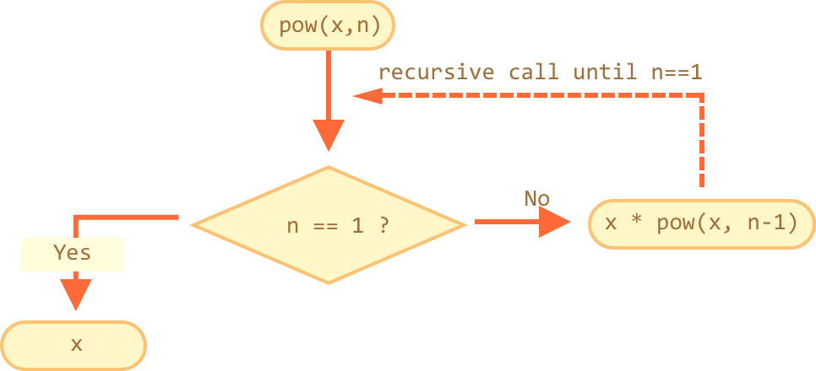
How Does It Work?
The function or method has a base case
Each step of the recursion should move towards the base case
269

Slide 270
Example: Array Sum
Sum(n - 1)
1
2 | 3 | 4
Sum(n)
Sum((n – 1) - 1)
1 | 2 | 3 | 4
1
2
3 | 4
Sum(((n – 1) - 1) – 1)
1
2
3
4
Base case

Slide 271
Example: Recursive Factorial
Recursive definition of n! (n factorial):
Pseudocode
N!
5
120
10
3628800
n! = n * (n–1)! for n > 0
0! = 1

Slide 272
Recursion Pre-Actions and Post-Actions
Recursive methods have 3 parts:
Pre-actions (before calling the recursion)
Recursive calls (step-in)
Post-actions (after returning from recursion)
static void recursion() {
// Pre-actions
recursion();
// Post-actions
}

Slide 273
Direct and Indirect Recursion
Direct recursion
a method directly calls itself
Indirect recursion
Method a calls b, method b calls a
Or even a → b → c → a
void a() {
…
a();
}
void a() {
…
b();
}
void b() {
…
a();
}

Slide 274
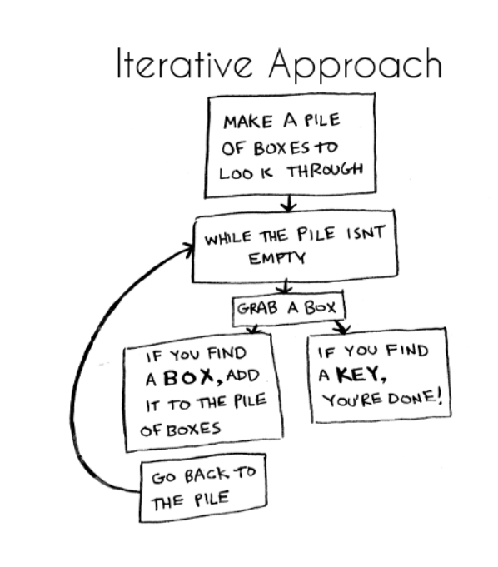
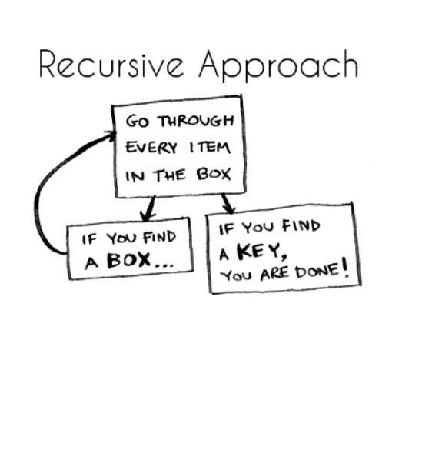
Iterative vs. Recursive Approach
A function repeats a defined process until a condition fails
A function that calls itself repeatedly until a certain condition is met
274

Slide 275

Recursion

Slide 276
Problem: Recursive Array Sum
Write a recursive method that:
Finds the sum of all numbers stored in an int[] array
Read numbers from the console
10
1 2 3 4
-1 0 1
0
Check your solution here: https://judge.softuni.bg/Contests/1701/Basic-Algorithms-Lab

Slide 277
Solution: Recursive Array Sum
static int sum(int[] array, int index) {
if (index == array.length - 1) {
return array[index];
}
return array[index] + sum(array, index + 1);
}
Check your solution here: https://judge.softuni.bg/Contests/1701/Basic-Algorithms-Lab

Slide 278

Problem: Recursive Factorial
Create a recursive method that calculates n!
Read n from the console
5
120
10
3628800
Check your solution here: https://judge.softuni.bg/Contests/1701/Basic-Algorithms-Lab

Slide 279
Solution: Recursive Factorial
static long factorial(int num) {
if (num == 0) {
return 1;
}
return num * factorial(num - 1);
}
Base case
Check your solution here: https://judge.softuni.bg/Contests/1701/Basic-Algorithms-Lab

Slide 280

Brute-Force Algorithms

Slide 281
Brute-Force Algorithms
Trying all possible combinations
Picking the best solution
Usually slow and inefficient
0
0
0
0
0

Slide 282
Brute-Force Algorithms
0
0
0
0
0

Slide 283
Brute-Force Algorithms
0
0
0
0
1

Slide 284
Brute-Force Algorithms
0
0
0
0
2

Slide 285
Brute-Force Algorithms
9
9
9
9
9
10 x 10 x 10 x 10 x 10 = 100,000 combinations

Slide 286

Greedy Algorithms

Slide 287
Greedy Algorithms
Used for solving optimization problems
Usually more efficient than the other algorithms
Can produce a non-optimal (incorrect) result
Pick the best local solution
The optimum for a current position and point of view
Greedy algorithms assume that always choosing a local optimum leads to the global optimum
287

Slide 288
Optimization Problems
Finding the best solution from all possible solutions
Examples:
Find the shortest path from Sofia to Varna
Find the maximum increasing subsequence
Find the shortest route that visits each city and returns to the origin city
288

Slide 289
Greedy Algorithms

Slide 290
Problem: Sum of Coins
Write a program, which gathers a sum of money, using the least possible number of coins
Consider the US currency coins
0.01, 0.02, 0.05, 0.10
Greedy algorithm for "Sum of Coins":
Take the largest coin while possible
Then take the second largest
Etc.
1$
1¢
50¢
5¢
25¢
4¢
Check your solution here: https://judge.softuni.bg/Contests/1701/Basic-Algorithms-Lab

Slide 291
Sum of Coins Visualization
Target: 18
10¢
5¢
2¢
1¢
10¢
5¢
2¢
1¢
Actual:
0

Slide 292
Sum of Coins Visualization
Target: 18
10¢
5¢
2¢
1¢
5¢
2¢
1¢
Actual:
10
10¢

Slide 293
Sum of Coins Visualization
Target: 18
10¢
5¢
2¢
1¢
2¢
1¢
Actual:
15
10¢
5¢

Slide 294
Sum of Coins Visualization
Target: 18
10¢
5¢
2¢
1¢
1¢
Actual:
17
10¢
5¢
2¢

Slide 295

Sum of Coins Visualization
Target: 18
10¢
5¢
2¢
1¢
Actual:
18
10¢
5¢
2¢
1¢

Slide 296
Greedy Algorithm for Sum of Coins

Slide 297
Solution: Sum of Coins (1)
public static Map<Integer, Integer>
chooseCoins(int[] coins, int targetSum) {
List<Integer> sortedCoins = Arrays.stream(coins).boxed()
.sorted(Collections.reverseOrder())
.collect(Collectors.toList());
Map<Integer, Integer> chosenCoins = new LinkedHashMap<>();
int currentSum = 0; int coinIndex = 0;
// Next slide
if (currentSum != targetSum)
throw new IllegalArgumentException();
return chosenCoins;
}
Check your solution here: https://judge.softuni.bg/Contests/1701/Basic-Algorithms-Lab

Slide 298
Solution: Sum of Coins (2)
while (currentSum != targetSum && coinIndex < sortedCoins.size()) {
int currentCoin = sortedCoins.get(coinIndex);
int remainder = targetSum - currentSum;
int numberOfCoins = remainder / currentCoin;
if (currentSum + currentCoin <= targetSum) {
chosenCoins.put(currentCoin, numberOfCoins);
currentSum += numberOfCoins * currentCoin;
}
coinIndex++;
}
Check your solution here: https://judge.softuni.bg/Contests/1701/Basic-Algorithms-Lab

Slide 299
Problem: Set Cover
Write a program that finds the smallest subset of S, the union of which = U (if it exists)
You will be given a set of integers U called "the Universe"
And a set S of n integer sets whose union = U
Universe: 1, 2, 3, 4, 5
Number of sets: 4
1
2, 4
5
3
Sets to take (4):
{ 2, 4 }
{ 1 }
{ 5 }
{ 3 }
Check your solution here: https://judge.softuni.bg/Contests/1701/Basic-Algorithms-Lab

Slide 300
Solution: Set Cover (1)
public static List<int[]> chooseSets(
List<int[]> sets, List<Integer> universe) {
List<int[]> selectedSets = new ArrayList<>();
Set<Integer> universeSet = new HashSet<>();
for (int element : universe) { universeSet.add(element);}
while (!universeSet.isEmpty()) {
// Next Slide
}
return selectedSets;
}
Check your solution here: https://judge.softuni.bg/Contests/1701/Basic-Algorithms-Lab

Slide 301
Solution: Set Cover (2)
int notChosenCount = 0;
int[] chosenSet = sets.get(0);
for (int[] set : sets) {
// Next slide
}
selectedSets.add(chosenSet);
for (int elem : chosenSet) {
universeSet.remove(elem);
}
Check your solution here: https://judge.softuni.bg/Contests/1701/Basic-Algorithms-Lab

Slide 302
Solution: Set Cover (3)
int count = 0;
for (int elem : set) {
if (universeSet.contains(elem)) {
count++;
}
}
if (notChosenCount < count) {
notChosenCount = count;
chosenSet = set;
}
Check your solution here: https://judge.softuni.bg/Contests/1701/Basic-Algorithms-Lab

Slide 303


Greedy Failure Cases

Slide 304
Sum of Coins Failure
Target: 18
10¢
5¢
4¢
1¢
10¢
5¢
4¢
1¢
10¢
5¢
4¢
1¢
Actual:
0

Slide 305
Sum of Coins Failure
Target: 18
10¢
5¢
4¢
1¢
10¢
5¢
4¢
1¢
5¢
4¢
1¢
Actual:
10
10¢

Slide 306
Sum of Coins Failure
Target: 18
10¢
5¢
4¢
1¢
10¢
5¢
4¢
1¢
4¢
1¢
Actual:
15
10¢
5¢

Slide 307
Sum of Coins Failure
Target: 18
10¢
5¢
4¢
1¢
10¢
5¢
4¢
1¢
4¢
Actual:
16
10¢
5¢
1¢

Slide 308
Sum of Coins Failure
Target: 18
10¢
5¢
4¢
1¢
10¢
5¢
4¢
4¢
Actual:
17
10¢
5¢
1¢
1¢

Slide 309
Sum of Coins Failure
Target: 18
10¢
5¢
4¢
10¢
5¢
4¢
4¢
Actual:
18
10¢
5¢
1¢
1¢
1¢

Slide 310

Sum of Coins Failure
Target: 18
10¢
5¢
1¢
1¢
1¢
10¢
4¢
4¢

Slide 311

Optimal Greedy Algorithms

Slide 312
Optimal Greedy Algorithms
Suitable problems for greedy algorithms have these properties:
Greedy choice property
Optimal substructure
Any problem having the above properties is guaranteed to have an optimal greedy solution

Slide 313
Greedy Choice Property
Greedy choice property
A global optimal solution can be obtained by greedily selecting a locally optimal choice
Sub-problems that arise are solved by consequent greedy choices
Enforced by optimal substructure

Slide 314
Optimal Substructure Property
Optimal substructure property
After each greedy choice the problem remains an optimization problem of the same form as the original problem
An optimal global solution contains the optimal solutions of all its sub-problems

Slide 315

Greedy Algorithms: Example
The "Max Coins" game
You are given a set of coins
You play against another player, alternating turns
Per each turn, you can take up to three coins
Your goal is to have as many coins as possible at the end

Slide 316
Max Coins – Greedy Algorithm
A simple greedy strategy exists for the "Max Coins" game
Always choose the local maximum (at each step)
You don't consider what the other player does
You don't consider your actions' consequences
The greedy algorithm works optimally here
It takes as many coins as possible
At each turn take the maximum number of coins

Slide 317

Simple Sorting Algorithms

Slide 318
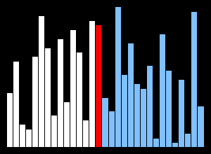
What is a Sorting Algorithm?
Sorting algorithm
An algorithm that rearranges elements in a list
In non-decreasing order
Elements must be comparable
More formally
The input is a sequence / list of elements
The output is an rearrangement / permutation of elements
In non-decreasing order

Slide 319

Sorting – Example
Efficient sorting algorithms are important for:
Producing human-readable output
Canonicalizing data – making data uniquely arranged
In conjunction with other algorithms, like binary searching
Example of sorting:
Unsorted list
sorting
Sorted list
10 | 3 | 7 | 3 | 4
3 | 3 | 4 | 7 | 10

Slide 320
Sorting Algorithms: Classification
Sorting algorithms are often classified by:
Computational complexity and memory usage
Worst, average and best case behavior
Recursive / non-recursive
Stability – stable / unstable
Comparison-based sort / non-comparison based
Sorting method: insertion, exchange (bubble sort and quicksort), selection (heapsort), merging, serial / parallel, etc.

Slide 321
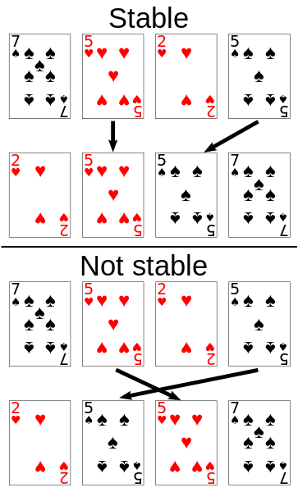
Stability of Sorting
Stable sorting algorithms
Maintain the order of equal elements
If two items compare as equal, their relative order is preserved
Unstable sorting algorithms
Rearrange the equal elements in unpredictable order
Often different elements have same key used for equality comparing

Slide 322
Bubble Sort
Bubble sort – simple, but inefficient algorithm (visualize)
Swaps to neighbor elements when not in order until sorted
Memory: O(1)
Stable: Yes
Method: Exchanging

Slide 323
BubbleSort

Slide 324
BubbleSort
int[] numbers = {1, 3, 4, 2, 5, 6};
for (int i = 0; i < numbers.length; i++) {
for (int j = i + 1; j < numbers.length - 1; j++) {
if (numbers[i] > numbers[j]) {
int tempNumber = numbers[i];
numbers[i] = numbers[j];
numbers[j] = tempNumber;
}
}
}
//TODO: Print numbers

Slide 325


Searching Algorithms

Slide 326
Search Algorithm
Search algorithm == an algorithm for finding an item with specified properties among a collection of items
Different types of searching algorithms:
For virtual search spaces
Satisfy specific mathematical equations
Try to exploit partial knowledge about a structure
For sub-structures of a given structure
A graph, a string, a finite group
Search for the min / max of a function, etc.

Slide 327
Linear Search
Linear search finds a particular value in a list (visualize)
Checking every one of the elements
One at a time, in sequence
Until the desired one is found
Worst & average performance: O(n)
for each item in the list:
if that item has the desired value,
return the item's location
return nothing

Slide 328
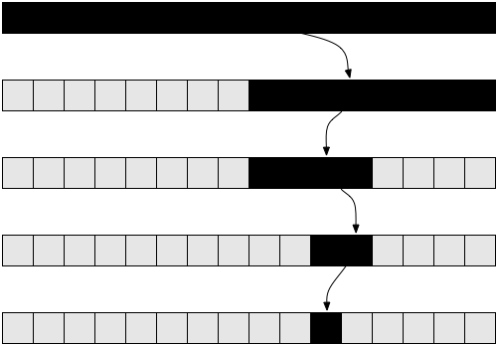

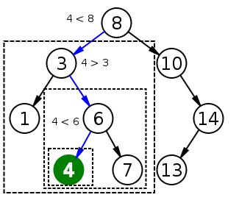
Binary Search
Binary search finds an item within a ordered data structure
At each step, compare the input with the middle element
The algorithm repeats its action to the left or right sub-structure
Average performance: O(log(n))
See the visualization

Slide 329
Binary Search (Iterative)
int binarySearch(int arr[], int key, int start, int end) {
while (end >= start) {
int mid = (start + end) / 2;
if (arr[mid] < key)
start = mid + 1;
else if (arr[mid] > key)
end = mid - 1;
else
return mid;
}
return KEY_NOT_FOUND;
}

Slide 330
Summary
Recursion – a method or a function that calls itself
Brute-Force - trying all the possible solutions
Greedy - picking a locally optimal solution
Sorting
Bubble Sort
Searching
Linear and Binary
…
…
…

Slide 331
Method Overloading is an example of
- Static Binding.
Dynamic binding uses which information for binding
- object.
What is an applet?
An applet is a Java program that runs in a Web browser.
What is the size of long variable?
64 bit
What is the size of short variable?
A - 8 bit
Can we compare int variable with a boolean variable?
False/Compile time error will occur if an int variable is compared with Boolean variable./

Slide 332
What is correct syntax for main method of a java class?
- public static void main(String[] args)
What is the default value of byte variable?
- 0
Can be constructor be made final?
False/
What is the default value of short variable?
-0
What is composition?
-Holding the reference of the other class within some other class is known as composition.
- Which of the following is true about super class?
A - Variables, methods and constructors which are declared private can be accessed only by the members of the super class.
B - Variables, methods and constructors which are declared protected can be accessed by any subclass of the super class.
C - Variables, methods and constructors which are declared public in the superclass can be accessed by any class.

Slide 333
What is the default value of long variable?
- 0L
Which of the following is true about protected access modifier?
Variables, methods and constructors which are declared protected can be accessed by any class lying in same package.
Under what conditions is an object's finalize() method invoked by the garbage collector?
- When it detects that the object has become unreachable.
What is inheritance?
- It is the process where one object acquires the properties of another.
When static binding occurs?
- Static binding occurs during Compile time.

Slide 334
What is instance variable?
Instance variables are variables within a class but outside any method.
- What is Abstraction?
It refers to the ability to make a class abstract in OOP.
Composition represents
HAS-A relationship.

